Slide 1
Blackjack Simulation in CSS and HTML
A project by: Joana Ibaro ,
Joshua King, and Hamel Patel

Slide 2
Starting out
We start this project by drawing out what we wanted the project to look like simply.
It came down to a page with a title and space for a dealer and space for players.
We need to have a number of players.
Then we needed to hand card to those players after a hit or move on to the next player after.

Slide 3
Basic information of the game blackjack
Most commonly is the casino version where chips are drawn
The version that we made was the one where there was no chips.
The basic system is that players get 2 cards and the objective is to get 21.
So players can hit or stay and once they find the values of there cards they do this.
If you go over 21 you lose.
Once everyone has gone around and done this then the players compare values and the winner is the one with closest to 21 or 21.

Slide 4
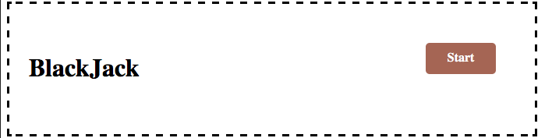
Start button
We need a way to initialize the game
The way we start that was using the start button along with the header.
Once you open up the index.html the start button initiates.

Slide 5

Players-HTML
We started out by having divs for each player.
There was 3 players because any more made an exponentially more number of cases.
Once we had the divs we used check boxes at first to give them values for hit and stay.

Slide 6
Cards
We ideally wanted to have an image for every card .
We had to limit to about 20 cards because it is very tedious .
Another reason we limited was so that we did not need more than 15.
We made classes so that they could be selected by there name in the CSS file (see next slide for image).
Each class had its own sub class for every card

Slide 7
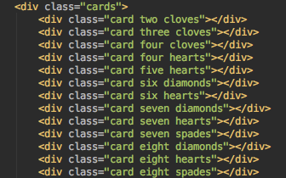
Screenshot for class of cards

Slide 8
Constraints
Time Constraint: We were not able to do as many hands of blackjack .
Language constraint: If we were able to use JavaScript we would have been able to do more rounds.
Language constraint: If we had been able to do math functions then we would have been able to introduce chip values which updated every round.

Slide 9
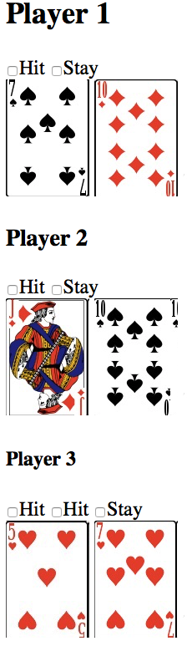
Algorithm
We had to devise an algorithm, the way we did it was to create cases.
Player 1 had cards that summed up to 17
Player 2 had cards that summed up to 20
Player 3 had cards that summed up to 12

Slide 10
Algorithm (continued)
Based on our resources we broke it up so that that player 1 & 2 were only allowed to hit once and player 3 was allowed to hit 2 times.
If we could do that then we would have 2^hits cases. In our game it was 2^4 cases.
With 16 cases you had to make sure the person who hit got the top card.
With this being said either a hit or a stay had to be checked and so on… so a card could be added.
We used the card classes to do this with 0-4 cards being drawn.

Slide 11
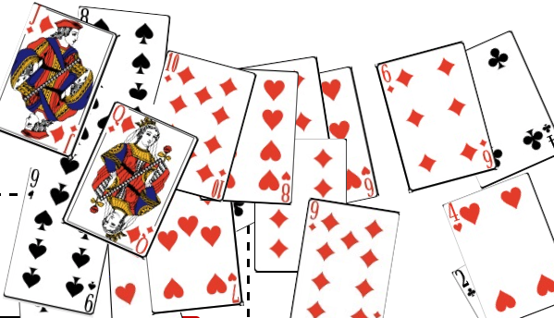
Animations
Once you hit the start button an animation occurs where all the cards shuffles in a random order .

Slide 12
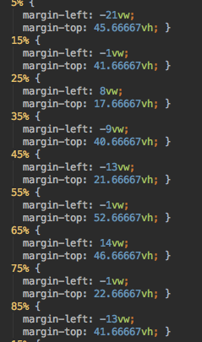
Screenshots of code used for shuffle

Slide 13
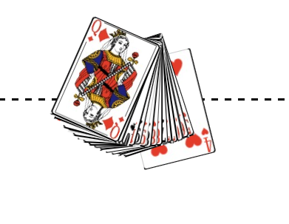
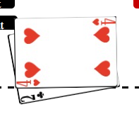
Animations(continued)
The shuffle continues to return to the dealer in a fan then it deals out the cards to the players with their initial 2 cards.
An example is below like with the 4 of hearts.

Slide 14

Buttons
The check box idea was good but we progressed.
We made them translucent so the we could still use the cases.
We used code in CSS for each of the hit and stays so that they were buttons and not checkboxs with text(code on next slide).

Slide 15
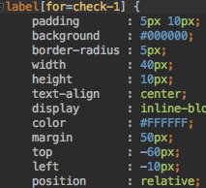
Screenshots of code used for Buttons

